Slide 1
Introduction to Computational Thinking
Sarah, Avery, Dan

Slide 2
Why study Computer Science at Rice?
What is the major like?
Why is it useful?
Why is it also useful outside the major?
Notes:
COMP 140: http://rice.codeskulptor.org/#user42_U8EzWQIBS8_48.py
COMP 182: POS tagging
Pretty pictures COMP 215
Ballworld: COMP 310
Comp as an engineer/elec

Slide 3
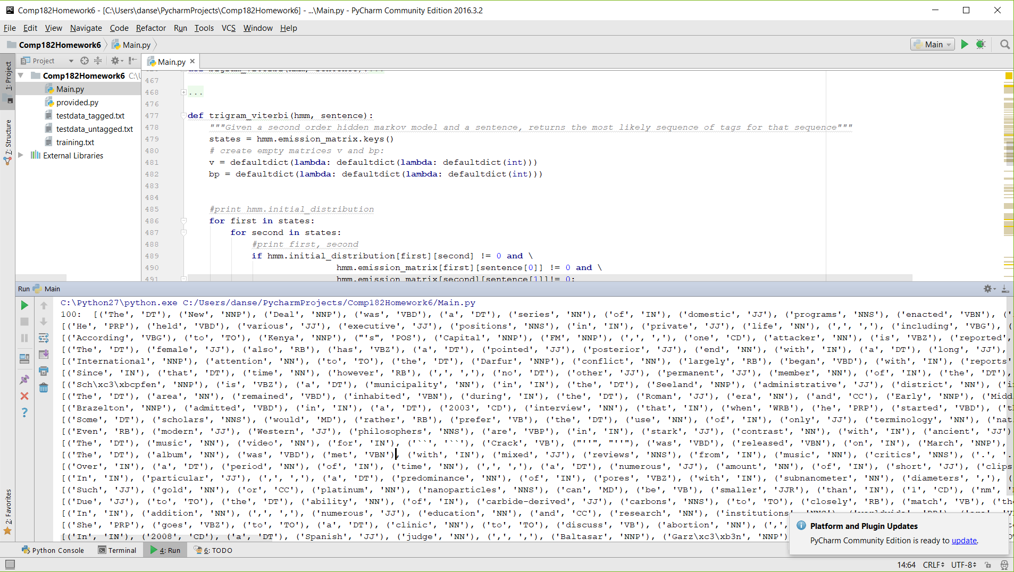

Slide 4
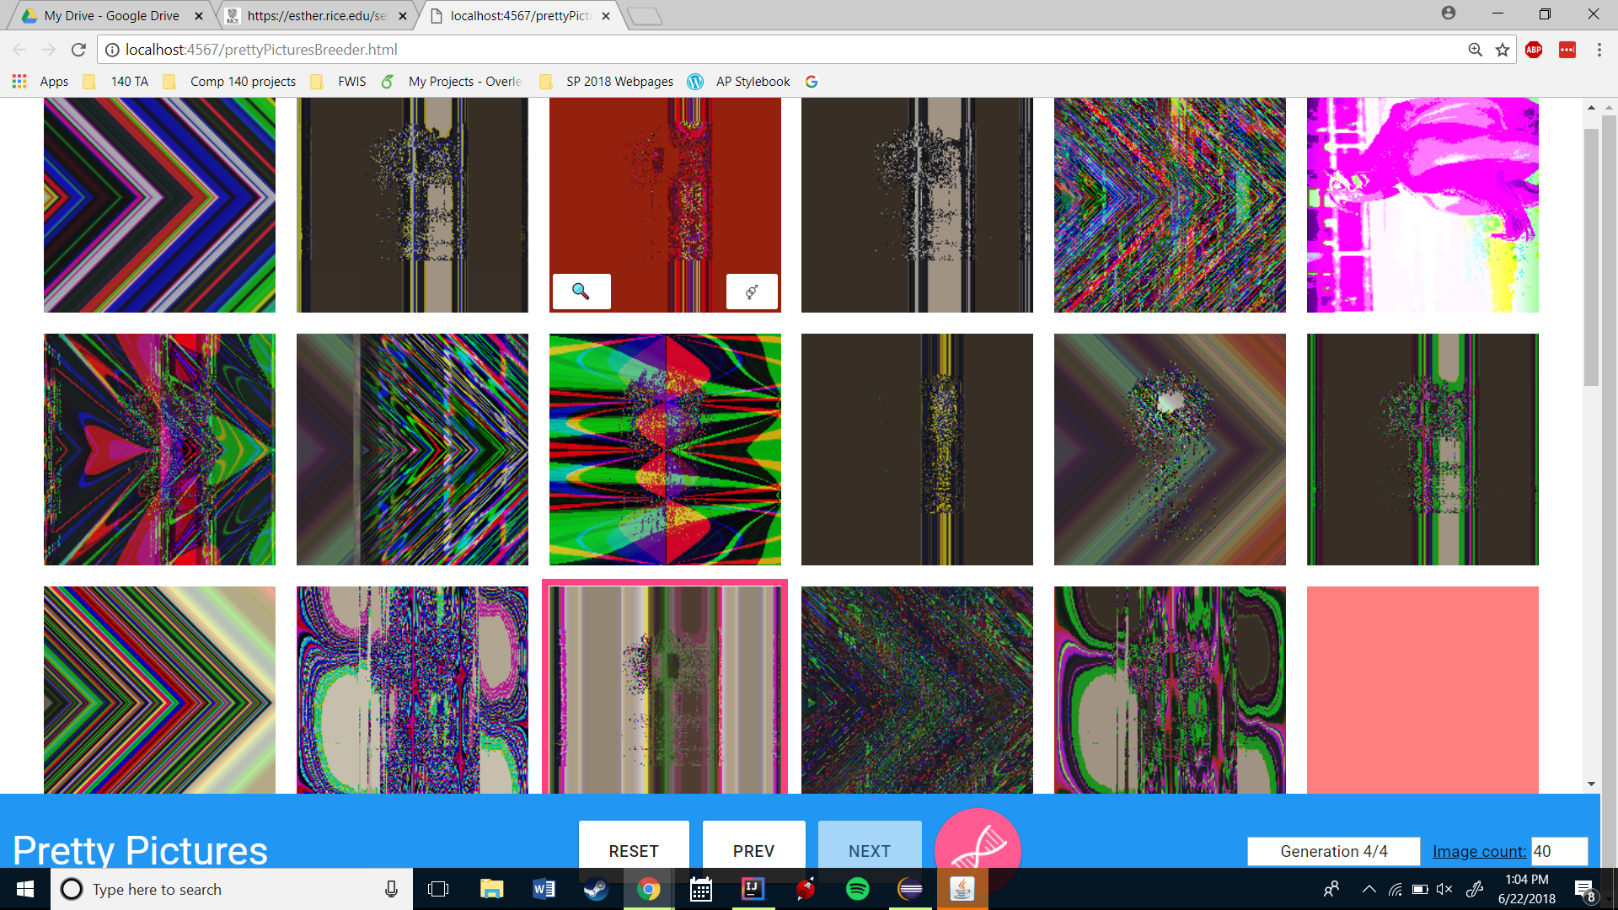

Slide 5
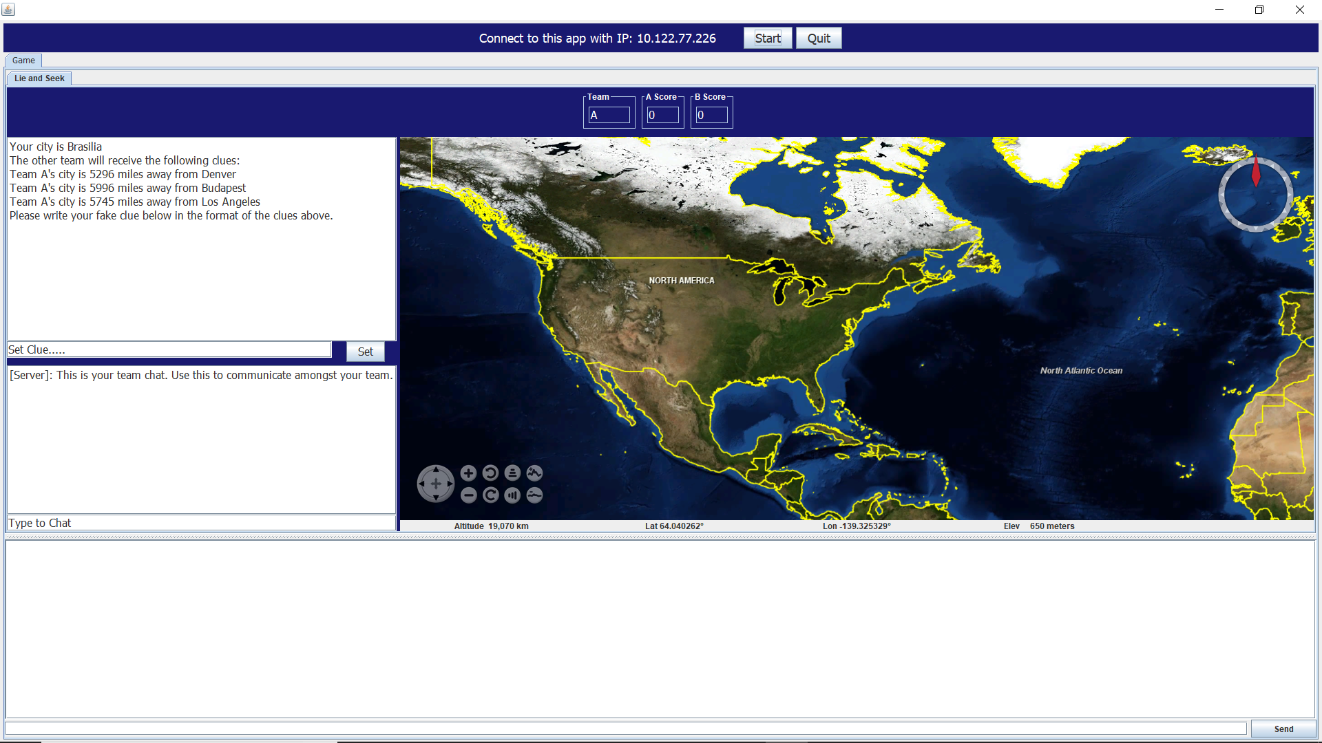

Slide 6
What is computational thinking?
Breaking down problems into manageable components
Conceptualizing, not programming
Generalizing solutions to multiple problems
Proving and defending solutions
Notes:
Before, showing them, talk about it.
Breaking down problems into manageable components:
-give a big example and what components were needed in doing it:
Emphasis on the conceptualizing, not programming portion
COMP 182: POS tagging: Read training data, train model, classify parts of speech, display data

Slide 7
The Process
Understand the objective
Determine the inputs
Decompose the problem
Design an algorithm
Implement the solution
Note: this is usually the easiest step, and the only part that involves code
Notes:
Map navigation:
Objective: Find the shortest path between two points:
Inputs: What do we need to solve this? Destination, Starting location, Map (Can be represented as a graph),
Design an algorithm: in this case, search all possible paths, record the shortest one and return it. ((Ask how they would do that)
Write code that does that stuff.

Slide 8
Python and CodeSkulptor
Programming requires two things:
A programming language
An IDE (Integrated Development Environment)
Freshman COMP classes use Python and rice.codeskulptor.org, an online IDE
Notes:
Do quick intro for codeskulptor

Slide 9
Hello World
Traditional first program in any language!
Open codeskulptor and write the following:
print “Hello World!”
Then run your program.
http://rice.codeskulptor.org/#user44_fjk9nM8aEW_0.py

Slide 10
Arithmetic in Python
Python has pretty much all basic math operations:
Addition: print 137 + 48
Subtraction: print 78 - 29
Multiplication: print 11 * 29
Division: print 1 / 2 (Does this print what you expect? Why? Can you make it print what you expect?)

Slide 11
Special Operations
Try the following bits of code. What do they do?
(Hint: feel free to test out different numbers)
print 3 ** 2
print 3 % 2

Slide 12
Assignment and Variables
Variables: Names associated with values.
Example:
x = 1
print x
We can also assign variables from other variables:
x = 1
y = x
print x, y

Slide 13
Operating on Variables
All the same operations we can do on numbers, we can do on variables (since they just represent numbers)
Ex:
x = 3
y = 2
print x * y
print x + y
print x - y
print x / y

Slide 14
Comments and Code Style
Descriptive variable names
Whitespace between code blocks
Comments! Comments! Comments!
Example:
#this is a comment

Slide 15
Python as a Calculator
We have a set of problems for you! Now you get to try coding something yourself!
Follow this link:
http://rice.codeskulptor.org/#user44_VYVlYZDYCRAdp6H.py
Notes:
Done by 2:50 in groups of 3

Slide 16
Thoughts on Assignment
What went well?
What was hard?
Is there anything you want explained in more detail before we go on?

Slide 17
Break Time

Slide 18
Functions
Functions are the building blocks of programs
Allow the same block of code to be run multiple times with different variables
Can be used to encode mathematical functions
Indent Properly!

Slide 19
Python Syntax of Functions
We could represent
f(x) = 3x + 4 in python with:
def f(x):
return 3*x + 4
We can also have functions with no arguments(inputs):
def do_stuff():
print “doing stuff”
Or multiple arguments:
def add(x,y):
return x + y

Slide 20
Basic Functions
Python has lots of built in functions. These are stored in modules.
import math
import random
print math.sqrt(9)
print random.randint(0, 10)

Slide 21
Documentation
One of the best resources when you run into something you don’t know
Open it with the Docs button in Codeskulptor
Syntax

Slide 22
Let’s Play With Functions
P.S. You can’t spell Function without Fun
http://rice.codeskulptor.org/#user44_27qhBDaw0uq5EgC.py
Notes:
Alternate who types between each question.
Write a function that given two points (represented as x and y coords) returns the midpoint and the distance between them
Write a function that applies the quadratic formula to find the roots of a quadratic equation denoted by ax^2 + bx + c, given a, b and c
Write a function that given an object’s initial velocity and angle returns the distance it travels and the time it takes to get there.
Write a function that computes the number of ways to select k objects from a set of n objects, if order doesn’t matter
*Write a function to compute the area of a triangle given the coordinates of its three points.

Slide 23
Documenting Code
It is standard practice in almost every language to document your functions. In python, we do this with docstrings.
def does_nothing():
“””Given nothing, does nothing interesting and outputs string sadness”””
return “sadness”

Slide 24
Functions?
Thoughts? Questions? Concerns?

